Slide 1


MINOR PROJECT
ON
Optimizing Fog Node Placement for IoT Performance
submitted by
AYUSH NAYAK 22052373
SRUJANA MISHRA 22053646
SAYAN PAL 22052055
SAMEER PUROHIT 2205061
DEBASISH BISOI 22052456
ARYAN MAHATO 22052447
UNDER THE GUIDANCE OF
PROF. PRASENJIT MAITI

Slide 2

IOT Devices
Cloud Computing
Cloud Computing Problems
Need For Fog Nodes
WHY THIS MATTERS ?
IoT refers to interconnected devices that collect and exchange data.
Over 29 billion IoT devices are expected by 2030
Traditionally, IoT data is sent to centralized cloud servers.
Cloud offers huge computational power and storage. Suitable for big data analytics and long-term storage.

Slide 3

WHY CLOUD ALONE ISN’T ENOUGH
High latency: Data travels far to reach the cloud.
Network congestion: Millions of devices send continuous data.
Scalability issues for real-time applications like healthcare, traffic control, etc.
Apps like smart cities, healthcare, and automation can’t afford delays
So we Need something that can reduce this delay , while being efficient.
Cloud is powerful, but not always fast or close enough

Slide 4
BRINGING THE CLOUD CLOSER TO THE GROUND
Fog computing Extends cloud capabilities closer to IoT devices
Acts as a middle layer between IoT and Cloud
Processes data locally, reducing delay
Fog nodes are local processing units (e.g., edge routers, micro data centers)
They reduce:
Latency
Bandwidth usage
Load on cloud
Ideal for time-sensitive applications
But how it actually reduces delay ?

Slide 5
FOG HELPS — BUT ONLY IF PLACED RIGHT
Not just how many fog nodes, but where you place them matters
Too many nodes ➝ high deployment & maintenance cost
Too few nodes ➝ bottlenecks, congestion, increased delay
Poor placement leads to
High latency
Underutilized resources
Goal: Optimal fog node placement to serve IoT efficiently

Slide 6
3.1 Project Planning:
The following steps will be followed to plan and execute the project development:
Define the Problem Statement
Clearly articulate the problem being addressed and the objectives of the project.
Conduct a Literature Review
Review existing research on fog computing, IoT, and latency optimization to identify gaps and opportunities.
Collect Requirements
Gather functional and non-functional requirements from stakeholders and relevant literature.
Set up the necessary software and hardware tools for simulating the IoT network and fog nodes.
Implement the simulation model using appropriate programming languages and tools in different scenarios.
Execute simulations with varying numbers of fog nodes and collect data on delay.
Analyze Results.
Prepare a comprehensive report detailing the methodology, results, and insights gained from the project.

Slide 7
3.2 Project Analysis:
After collecting the requirements and conceptualizing the problem statement, the following steps will be taken to analyze the project:
Identify Ambiguities
Review the problem statement and requirements to identify any ambiguities or inconsistencies.
Validate Requirements
Ensure that the requirements are complete, consistent, and feasible.
Assess Risks
Identify potential risks and challenges that may arise during the project and develop mitigation strategies.
Refine the Problem Statement:
Based on the analysis, refine the problem statement to ensure clarity and focus.

Slide 8
3.3 System Design:
3.3.1 System Architecture :
Three-layer architecture:
IoT Device Layer – Sensors and devices that collect data.
Fog Computing Layer – Intermediate processing units (fog nodes) that reduce latency by handling data closer to IoT devices.
Cloud Layer – Centralized storage and processing for long-term analytic
3.3.2 Hardware and Software Components :
Software Tools:
Simulation software (e.g., Python) for modeling the IoT network and fog nodes.
Statistical tools for data analysis and visualization.
Hardware Requirements:
IoT Devices: Sensors, actuators, and communication modules
Fog Nodes: Edge servers or computing units handling intermediate processing.
A computer with sufficient processing power and memory to run simulations.
Internet connectivity for accessing relevant literature and tools.
Communication Technologies: Wi-Fi, 5G, or LPWAN used for data transfer between layers.

Slide 9
IMPLEMENTATION AND METHODS
Objective:
Identify how the number of fog nodes affects network delay in an IoT environment.
Data Collection and Device Distribution
Simulation Setup:
Simulate two IoT network scenarios: one with 100 devices and another with 10,000 devices.
Device Distribution:
Used the Poisson distribution to find how many devices are likely to be present in a given area , randomly distributed the IoT devices over the network area, ensuring a realistic and variable spread..
Cluster Formation and Fog Node Placement
Algorithm Selection:

Slide 10
Apply K-means clustering to group the IoT devices into clusters.
CLUSTERING PROCESS:
The K-means algorithm is used to partition the devices into a specified number of clusters (e.g., 15, 20, or 30 clusters).
The centroid of each cluster, which represents the average position of all devices in the cluster, is identified.
FOG NODE PLACEMENT
Place a fog node at the centroid of each cluster, ensuring that the nodes are positioned where they can optimally manage and process data from nearby devices.

Slide 11
DATA AGGREGATION
Calculate performance metrics such as mean delay , efficiency across the network for each configuration.
GRAPHICAL REPRESENTATION:
Plot graphs of network delay as a function of the number of fog nodes to visualize the performance trends.
OPTIMAL CONFIGURATION OPTIMISATION
Identify the point at which adding more fog nodes does not result in significant delay improvements.

Slide 12
Here are some common *methods you could have used for Fog Node Placement*:
1. *KMeans Clustering* (What you used)
- Groups IoT devices into k clusters.
- Places fog nodes at the cluster centers.
- Simple, efficient, and effective when number of fog nodes (k) is known.
2. *DBSCAN (Density-Based Spatial Clustering)*
- Does *not require number of clusters* beforehand.
- Can detect *arbitrary-shaped clusters*.
- Suitable when fog nodes should be placed only in dense IoT regions.
Use case: If IoT devices are unevenly distributed.

Slide 13
METHODS & RESULT ANALYSIS
Finding of IoT Device Density Using Poisson Distribution
In Agriculture, IoT devices (sensors) are used to collect data like soil moisture and temperature.
These devices are randomly placed across large farmland (1 km²).
A Fog Node is placed near the field to process this data locally before sending it to the cloud.
We need to know how many IoT devices a fog node might need to handle.

Slide 14
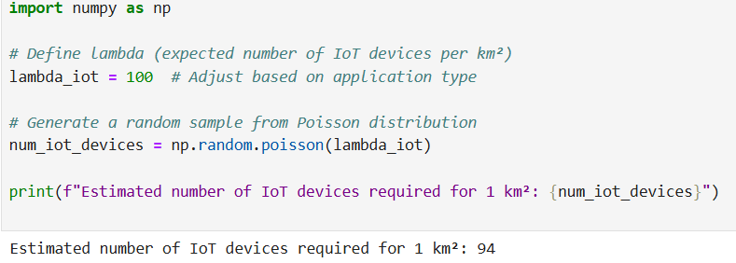
Poisson Distribution Helps Estimate Fog Node Capacity
Poisson distribution gives us predicted number of IoT devices in a given area.
We use Poisson to simulate real-world scenarios.
From simulation, we see:
Sometimes there are 90 devices,
Sometimes 110,
Sometimes 103 — this shows variation..

Slide 15
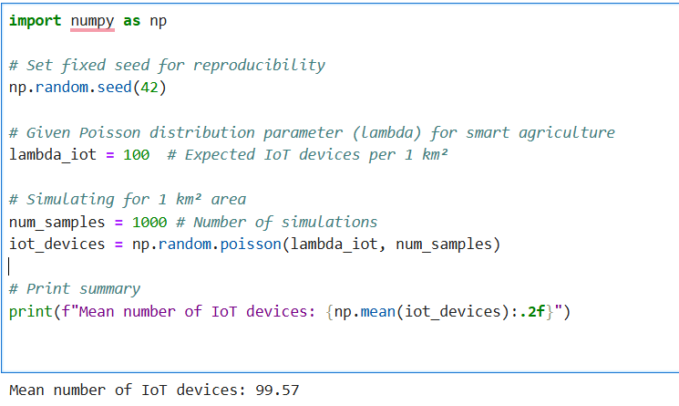
We updated the code to make the output consistent and reliable.
Instead of just 1 value, we now generate 1000 values and take the mean,
so we get a realistic estimate of how many IoT devices are needed per 1 km².

Slide 16
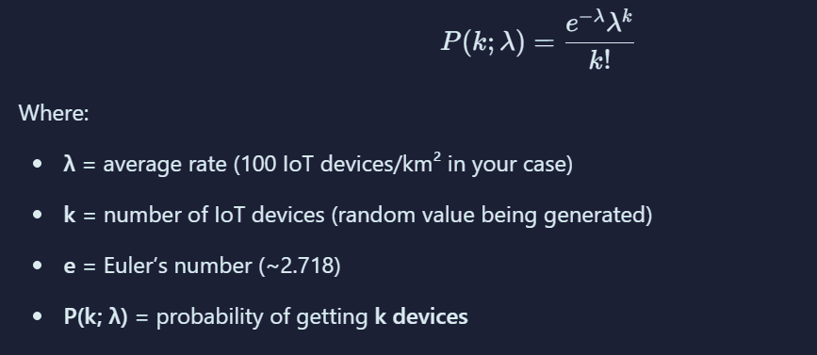
We are using Poisson Distribution because:
There is no fixed pattern for how they are distributed in 1 km².
We are studying the number of devices in a fixed area (1 square kilometer)
The placement of one device does not affect the placement of another which means events are independent of each other and it’s a key condition for applying poisson’s distribution.
Poisson Distribution is used when we know the average rate (λ) and want to predict the probability of a certain number of events happening.
Formula
λ = average rate (100 IoT devices/km² in your case)
k = number of IoT devices (random value being generated)
e = Euler’s number (~2.718)

Slide 17
Fog Node Placement Simulation using K-Means Clustering
We are simulating where to place fog nodes in a 1 km² smart area with 100 IoT devices so that:
Devices are close to fog nodes
Data reaches fog nodes within less delay
Fog nodes are efficiently placed
We are using:
K-Means Clustering to group IoT devices and find optimal fog node locations.
Distance calculations to check if fog nodes are within latency range we use of euclidean distance.

Slide 18
We use K-Means Clustering because:
We already know how many fog nodes (clusters) we need.
K-Means is simple and efficient for fixed number of clusters.
It helps us find the best possible placement for fog nodes.
Groups IoT devices based on minimum distance to a fog node.
Optimizes fog node locations to cover more IoT devices with less latency.
Euclidean distance helps us:
Check if fog nodes are within the allowed latency range.
Optimize placement to minimize delays between nodes and devices.
Latency is proportional to distance, so we use Euclidean distance to find the delay.
.

Slide 19
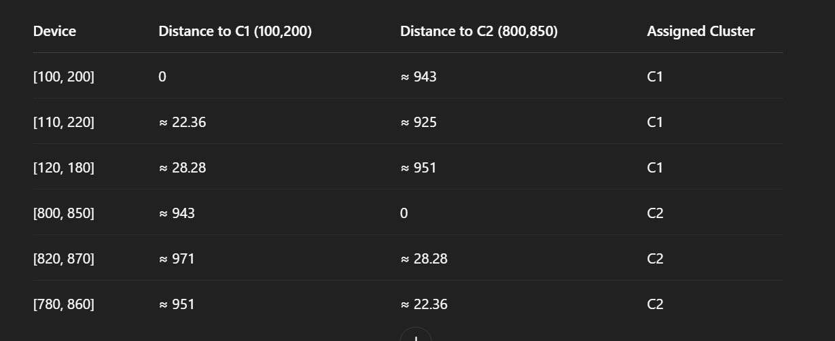
iot_devices =
[100, 200],
[110, 220],
[120, 180],
[800, 850],
[820, 870],
[780, 860]
num_fog_nodes = 2
Suppose we randomly pick:
Centroid 1: [100, 200]
Centroid 2: [800, 850]
So, cluster groups:
C1 = [ [100, 200], [110, 220], [120, 180] ]
C2 = [ [800, 850], [820, 870], [780, 860] ]

Slide 20
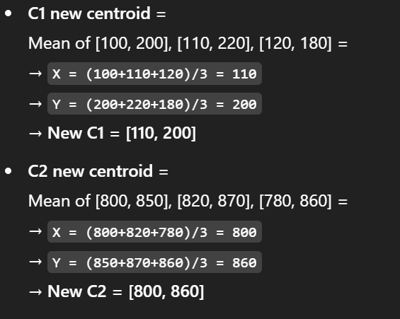
This entire process is repeated until we have same clusters with different starting centroids, and the one with lowest total distance is selected.

Slide 21
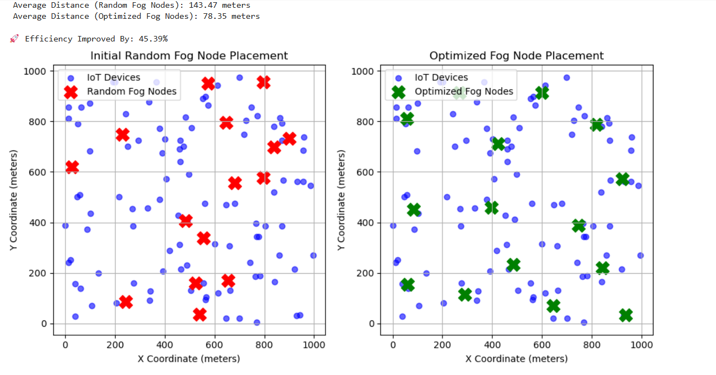

Slide 22
.
Used KMeans clustering to group IoT devices.
Each cluster center became an optimized fog node location.
Compared it with random fog node placement.
Initial (Random Fog Node Placement):
Shows poor coverage
High average distance (~143.47 meters)
Optimized (After KMeans):
Better placement close to IoT clusters
Lower average distance (~78.35 meters)

Slide 23
Efficiency Formula:
Efficiency (%) = ((Average Random Distance - Average Optimized Distance) / Average Random Distance) * 100
Where:
Average Random Distance = Mean of distances from each IoT device to its nearest fog node in random placement
Average Optimized Distance = Mean of distances from each IoT device to its nearest fog node in optimized (KMeans) placement
Efficiency in this context means:
How close (on average) are IoT devices to their nearest fog node
If devices are close to fog nodes, we get:
Less latency
Faster data transfer
Better resource utilization

Slide 24
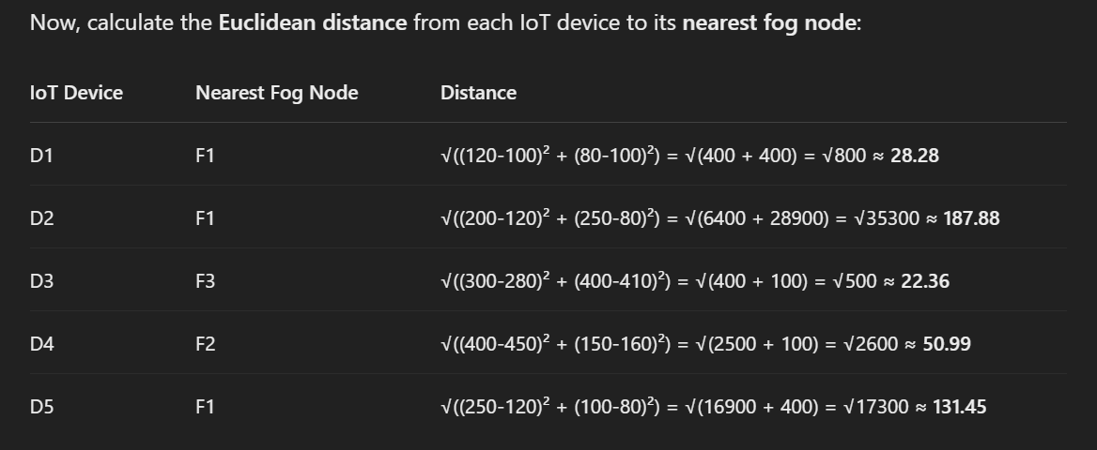
Random Fog Nodes:
F1: (120, 80)
F2: (450, 160)
F3: (280, 410)
Given, IOT Device Coordinates:
D1: (100, 100)
D2: (200, 250)
D3: (300, 400)
D4: (400, 150)
D5: (250, 100)
Average Random Distance
= (28.28 + 187.88 + 22.36 + 50.99 + 131.45) / 5
= 84.59 units

Slide 25
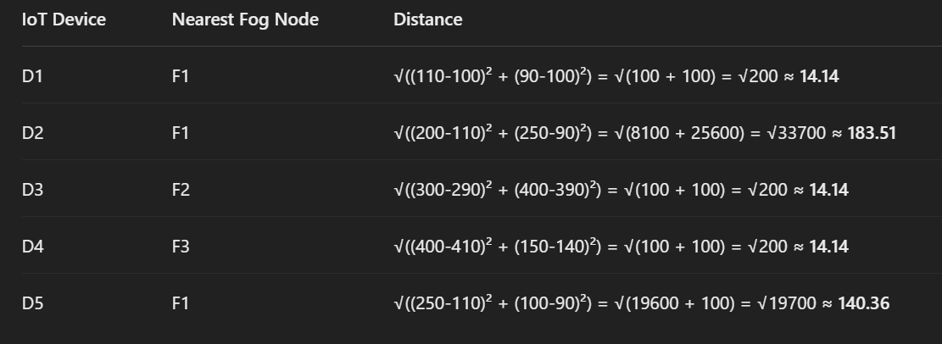
Optimized Fog Nodes:
F1: (110, 90)
F2: (290, 390)
F3: (410, 140)
Average Optimized Distance
= (14.14 + 183.51 + 14.14 + 14.14 + 140.36) / 5
= 73.26 units
Efficiency Improvement:
= ((84.59 - 73.26) / 84.59) * 100 ≈ 13.41% improvement

Slide 26
OUR TESTING CONDITIONS
In our study, we analyzed two IoT scenarios
Agriculture Scenario – A network with 100 IoT devices used for precision farming, automated irrigation, and environmental monitoring.
Smart City Scenario – A large-scale network with 10,000 IoT devices used for traffic management, pollution monitoring, and public safety applications.
For both scenarios, we tested the impact of different numbers of fog nodes under three cases:
Case 1: 1 to 15 fog nodes
Case 2: 1 to 20 fog nodes
Case 3: 1 to 30 fog nodes
This resulted in a total of six observations, three for each scenario.

Slide 27
WHY WE HAVE SELECTED 100 AND 10000 IOT DEVICES PER 1 KM SQUARE AREA
Agriculture has lower IoT density but growing steadily due to tech adoption.
India is a agricultural land , it todays tech generation framing is done very traditionally , introduction of iot devices and fog nodes taking time for adaptability . But many farmers where converting their traditional methods and opting for advanced tech features for farming . this is a slowly growing market . therefore today in india for basic smart agriculture farming Avg. no of iot devices used ranges from 50-100 which contribute in soil sensors , weather sensors, irrigation systems. Now it is a adapting market but in 5-10 years it will increase technology use in framing , advanced dones will be introduced and many different sensors will be introduced which will increase the iot density upto 300-500 in upcoming years
Smart cities like Bengaluru, Hyderabad, Pune, and parts of Delhi are deploying thousands of sensors for:
Smart traffic (cameras, counters, signals) Environmental monitoring (air, noise, water sensors), Utilities (smart meters,wastebins,streetlights ), Public infrastructures. Such density is especially common in smart streets, business hubs, and tech corridors, making it a valid assumption for modeling fog computing scenarios.
For ex - Gurugram’s Cyber Hub & Pune Smart Zones: Potentially hit 8,000–12,000 devices/km² during peak hours.
ex - Pimpri-Chinchwad: Installed 10,000 smart water meters city-wide, and in denser sectors
Therefore , having 10000 iot devices per km square area is becoming very common in todays growing world.

Slide 28

FOG NODES - (1 TO 15)
IOT DEVICES - 100
AREA OF THE PLOT :- 1KM SQUARE
CASE-1
AGRICULTURAL SCENARIO
CASE-2
FOG NODES - (1 TO 20)
IOT DEVICES - 100
AREA OF THE PLOT :- 1KM SQUARE
CASE-3
FOG NODES - (1 TO 30)
IOT DEVICES - 100
AREA OF THE PLOT :- 1KM SQUARE

Slide 29
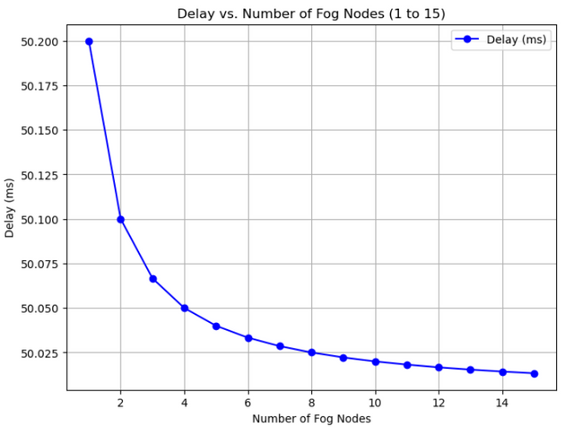
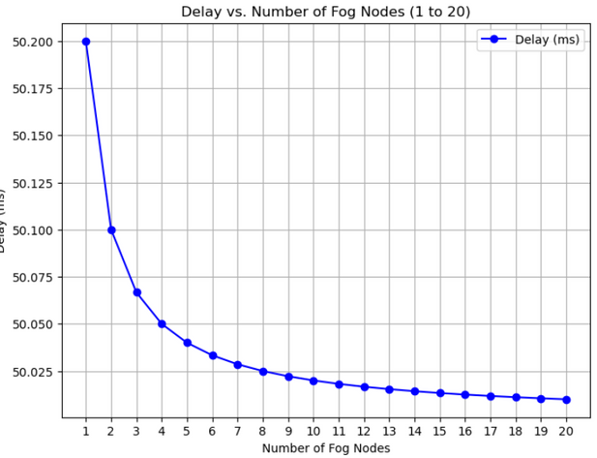
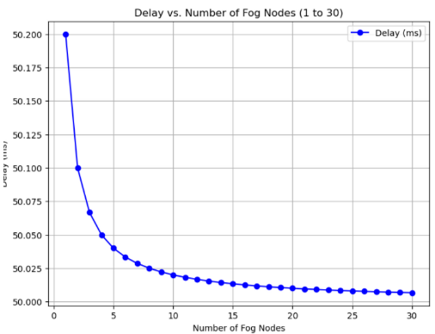
DELAY VS NO OF FOG NODES GRAPH
CASE - 1
CASE - 2
CASE - 3

Slide 30
% CHANGE IN DELAY
Percentage Decrease in Delay=(Delayinitial​​−Delaynew​​)/ Delay initial × 100
CASE 1
CASE 2
CASE 3
From 1 to 3 nodes: -0.27%
From 3 to 5 nodes: -0.05%
From 5 to 7 nodes: -0.02%
From 7 to 9 nodes: -0.01%
From 9 to 11 nodes-0.008%
From 11 to 13 nodes:-0.006%
From 13 to 15 nodes:-0.004%
From 15 to 17 nodes:-0.003%
From 17 to 20 nodes:-0.002%
From 1 to 3 nodes: -0.27%
From 3 to 5 nodes: -0.05%
From 5 to 7 nodes: -0.02%
From 7 to 9 nodes: -0.01%
From 9 to 11 nodes: -0.008%
From 11 to 13 nodes: -0.006%
From 13 to 15 nodes: -0.004%
From 15 to 17 nodes: -0.003%
From 17 to 20 nodes: -0.002%
From 20 to 23 nodes: - 0.0018%
From 23 to 26 nodes: - 0.0016%
From 26 to 30 nodes: - 0.0015%
From 1 to 3 nodes: -0.27%
From 3 to 5 nodes: -0.05%
From 5 to 7 nodes: -0.02%
From 7 to 9 nodes: -0.01%
From 9 to 11 nodes: -0.008%
From 11 to 13 nodes: -0.006%
From 13 to 15 nodes: -0.004%

Slide 31
CASE - 1
FOG NODES - (1 TO 15)
IOT DEVICES - 10000
AREA OF THE PLOT :- 1KM SQUARE
SMART CITY
SCENARIO
CASE - 2
FOG NODES - (1 TO 20)
IOT DEVICES - 10000
AREA OF THE PLOT :- 1KM SQUARE
CASE - 3
FOG NODES - (1 TO 30)
IOT DEVICES - 10000
AREA OF THE PLOT :- 1KM SQUARE

Slide 32
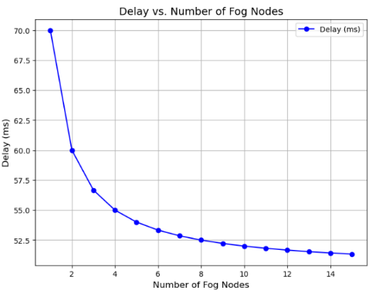
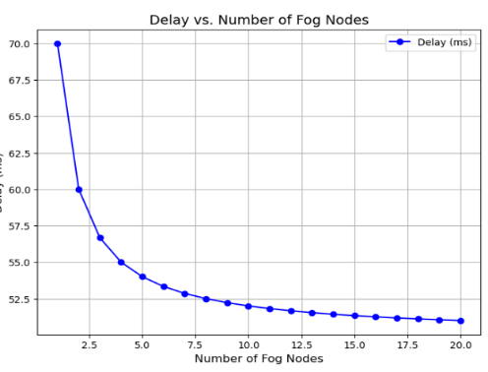
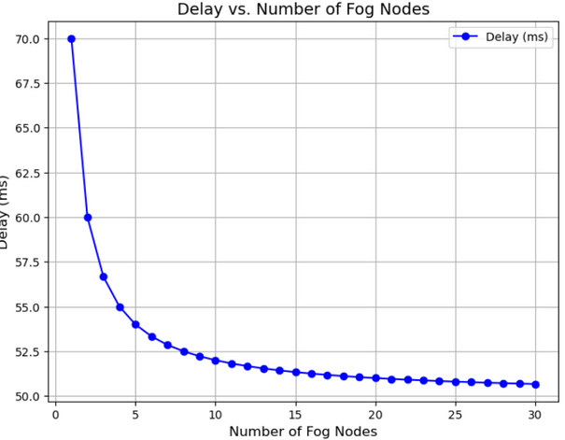
DELAY VS NO OF FOG NODES GRAPH
CASE 1
CASE 2
CASE 3

Slide 33
Our Findings
We had calculated total delay of iot devices , it composes of two types of delays - 1. Processing Delay , 2. Communication Delay
[Total Delay = Processing Delay + Communication Delay]
processing delay is based on how many devices each fog node handles
Communication delay represents the time it takes for data to reach the fog node
[delay = (n_devices / (fog_nodes * C)) + T_comm]
we focused on the two most impactful and measurable delays:
Processing delay → directly affected by the number of fog nodes
Communication delay → represents the time it takes for data to reach the fog node
These two delays dominate the total time it takes for an IoT task to complete, especially in time-sensitive applications like smart farming and smart cities.
we wanted a realistic but not overly complex model so we had selected this two delays , Other Delays Are Either Negligible or Complex to Simulate example - Transmission Delay is Often negligible in local fog networks (Packet size / Bandwidth) , Queuing Delay- Hard to simulate without modeling traffic load patterns
Therefore , we excluded to keep the model focused and simple
we will consider other delays in our major project

Slide 34
In fog computing systems, the processing delay contributes the most to overall delay
When fog nodes are overloaded or poorly distributed, processing becomes the main bottleneck, making it the dominant component of total delay in such systems. In our simulation, we used a fixed communication delay to simplify the model and reflect a stable network environment This allowed us to focus on processing delay.
The results from both scenarios clearly demonstrated that integrating a fog computing layer between IoT devices leads to reduction in delay , as we can see Increasing the number of fog nodes initially reduces delay. This is because more fog nodes mean tasks are processed closer to the IoT devices, reducing the time taken for data transmission and processing . This includes reduced network latency, faster response times. These improvements were consistent across both Agriculture and Smart City application.
However, after a certain point, the reduction in delay becomes minimal. This happens because once a sufficient number of fog nodes are available, adding more does not significantly improve efficiency
Beyond a certain threshold, adding extra fog nodes does not provide any noticeable benefit. Instead, it may lead to unnecessary resource allocation, increased management complexity, and additional overhead without improving performance.

Slide 35
Selection Of Optimal Fog Node
CASE - 1
(Agriculture scenario)
From 0 to 1 node, you see meaningful delay reduction (up to 50.2 to 50.1 ms cumulatively).
Beyond 1 node, each addition reduces delay by less than 0.025, which is not cost-justified.
implementing 1fog nodes is optimal for 100 iot devices .
CASE - 2
(Smart City Scenario scenario)
From 0 to 10 node, you see meaningful delay reduction (from 70 to 52 ms cumulatively).
fom 10 to 20 node, you see meaningful delay reduction (from 52 to 51 ms cumulatively).
Beyond 20 node, each addition reduces delay by less than 0.05, which is not cost-justified.
implementing 20 fog nodes is optimal for 10000 iot devices .
To determine the optimal number of fog nodes, we evaluated both performance and cost-efficiency. Performance was assessed by total delay and its rate of reduction with each added node. Cost-efficiency was judged .
we had assumed that a single fog node can handle 500 devices , which is a practical and conservative estimate for general-purpose IoT tasks such as smart home data, wearables, and environmental sensors.

Slide 36

Conclusion
This project demonstrates that deploying additional fog nodes substantially reduces network delay up to an optimal point, after which further additions provide minimal benefits. By strategically placing fog nodes using K-means clustering, the system balances performance gains and resource utilization, emphasizing the importance of identifying an optimal fog node configuration for scalable and efficient IoT networks

Slide 37
THANK YOU

